Slide 1
The Unit Circle

Slide 2
The Unit Circle
Centered at the origin
Has a radius of 1
Called the “unit circle” since the radius is 1 unit.

Slide 3
These are the main degrees of the unit circle.
These angles are important because they are based off of special right triangles. We will investigate that shortly.

Slide 4
Radian measurements

Slide 5
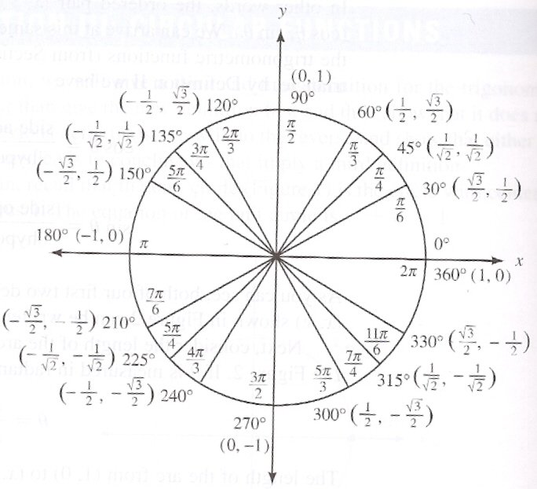
30°
30°
45°
45°
60°
60°
60°
30°
30°
45°
45°
60°
45°
30°
30°
30°
45°
60°
60°
45°
60°
30°
60°
45°

Slide 6
Now let’s investigate how this relates to special right triangles.

Slide 7
30-60-90 Triangles
What are the side lengths of this triangle if the hypotenuse is 1?
60°
1
30°

Slide 8
What if I put this triangle into the unit circle…
What is the ordered pair at this point?
1
60°
Look familiar?
30°

Slide 9
Now lets flip the triangle so that the angle at the origin is 60°
What is the ordered pair at this point?
1
30°
60°

Slide 10
Now lets rotate the triangle over the y-axis
What is the ordered pair at this point?
30°
1
The x-value becomes negative since it’s in Quad II
60°

Slide 11
45-45-90 Triangles
What are the side lengths of this triangle if the hypotenuse is 1?
45°
1
45°

Slide 12
Lets put the 45-45-90 triangle into the unit circle.
What is the ordered pair at this point?
45°
1
45°

Slide 13
Now lets flip the triangle over the y-axis
What is the ordered pair at this point?
45°
1
45°
Don’t forget we are in Quad II, so the x-value is negative

Slide 15
Recall the acronym SOH – CAH – TOA?
SOH → Sine – opposite over hypotnuse
CAH → Cosine – adjacent over hypotnuse
TOA → Tangent →opposite over adjacent

Slide 16
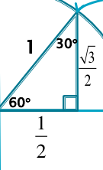
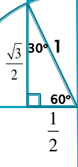
Consider finding the sine, cosine, and tangent for each.

Slide 17
Notice!
The sine of each angle is equal to the
y-coordinate in the unit circle.
The cosine of each angle is equal to the
x-coordinate in the unit circle.
Since tangent is opposite over adjacent, tangent is equal to y over x.
This is why we use the unit circle!

Slide 18
Find the value of each.

Slide 19
tan(60º)
Since we have division of fractions, we would flip and multiply to simplify this expression.

Slide 20
Answers:

Slide 21
Find the value of each.

Slide 22
Think about coterminal angles!
Many times, an angle that we’re working with isn’t literally within our circle. However, we can use coterminal angles.
Ex: cos(-630º)
-630 +360 = -270 (still not in circle)
-270 + 360 = 90 (in the circle!)
So cos(-630º) = cos(90º) = 0

Slide 23
Coterminal Angles in Radians

Slide 24
Answers

Slide 25
To prepare for next year…
In your future math courses, you will be given timed quizzes on your ability to create the unit circle.
With the blank circle that I have posted, try creating the filled-in version as fast as you can. Practice this numerous times until you can do it in under 5 minutes!

